Slide 1
Implementation of a Design Review Application
Using Virtual Reality- and Gesture Recognition Technology

Slide 2
About the Application
A virtual reality model inspector
All tasks can be executed by the use of gestures

Slide 3
Motivation
3D models have been important in several industries for decades, yet little has happened in how they are worked and interacted with.
The 3D models themselves are using three dimensions, but are still interfaced in 2D. E.g.:
Input: The mouse is using 2D
Output: Displays produces 2D images.
Virtual Reality- and Gesture Recognition Technology can change this, thus possible enabling a better use of the 3D models themselves.
Input: By capturing actions performed by the users hand in three dimensions
Output: VR headset with stereoscopic vision (individual feed per eye)
The options for 3D model collaboration platforms are also sparse.
Thus much information often end up being stored outside of the model.

Slide 4
Goals: The Digital Design Review Workflow
Make information more organised by having it present directly in a 3D model
Improve collaboration and communication between designer and approval engineer
E.g by showing them areas of attention in the model during a virtual design review meeting
Keep a history of all the changes made to the design and the 3D model
Make the work done during the design phase more accessible during surveys
Improve 3D perception and interaction with virtual reality- and gesture recognition technology

Slide 5
The Intersection of Many Fields
Virtual Reality Technology
Big impact on application design and performance aspects
3D Rendering Techniques
Many formats (at least >50), complex models.
Game Engine Ecosystems
Viable platforms for 3D- and VR-based applications
Gesture Recognition Technology
Offers promising interaction possibilities, but often have reliability issues
Network Technology (e.g. with regard to “multiplayer aspects”)
VR can make lag, jitter and packet loss more critical
Security (many strictly proprietary 3D models)
Sometimes desirable to never have the models themselves on the web

Slide 6
State of the Art
Virtual Reality Technology:
Oculus Rift CV1 and HTC Vive recently released.
2160×1200 resolution (1080x1200 per eye) at a refresh rate of 90 Hz.
OLED displays/lenses with a field of view (fov) of about 110 degrees.
Tracking system both in the headset and outside it (e.g “base stations”).
Solid SDKs that provides high level abstractions to the hardware
Game Engines:
Have generally become more mature, standardized and user-friendly with a broader scope (more commonly used simulators, visualizations etc).
Often have built-in support or libraries for 3rd party software or peripherals.
Often offer good deals for indie developers
E.g Unity Personal is free for companies making less than $100k/year
Most popular publicly available ones: Unity, Unreal Engine, CryEngine.

Slide 7
State of the Art Cont.
(Hand) Gesture Recognition Technology:
Vision-based and contact-based the primary categories.
Contact-based has a longer history and more competing products, but vision-based is deemed more promising.
E.g. It doesn’t require the user to wear anything.
Most research on vision-based today (closely related to image processing and computer vision fields)
Relatively few consumer-oriented vision-based hand gesture recognition systems available to day, with Leap Motion being one of them.
Several companies working at consumer-oriented GRT devices
Several of these after the release of the commercial virtual reality devices.

Slide 8
Design Choices
The necessary tool for making the transition from 2D to 3D

Slide 9
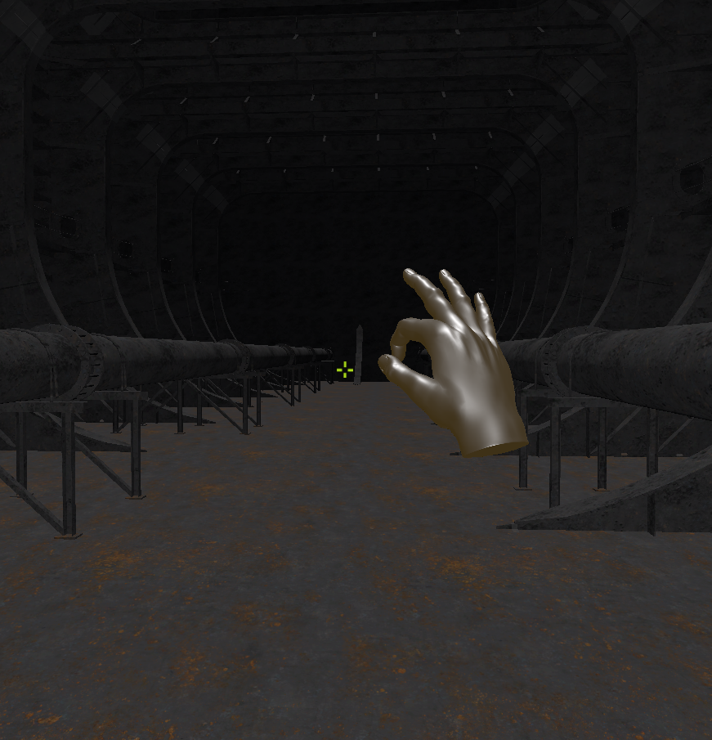
Navigation
The user is able to navigate a 3D model using either mouse and keyboard, or gestures.
Rotation is done by performing a pinch gesture and moving the hand in the desired rotation direction.
Movement is handled by one gesture per axis: Left/right (x-axis), up/down (y-axis) or forward/backward (z-axis).
The user can also “combine” these three gestures into one.

Slide 10
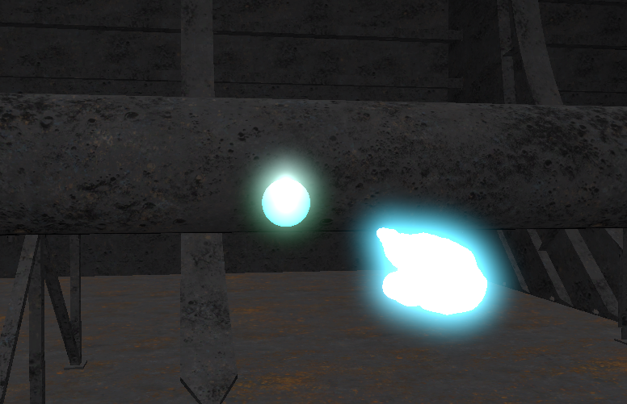
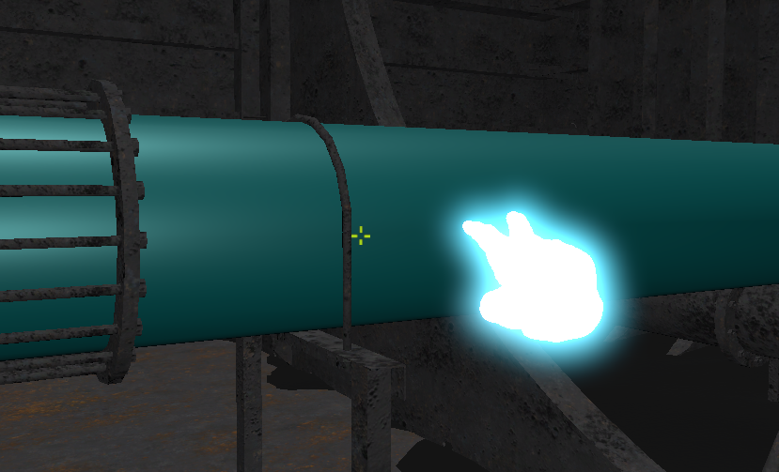
Creating annotations
The user can either create point annotations or object annotations.
These can hold information related to the location or object they are attached to.
Point annotations are sphere 3D objects that attach to the surface of other objects, and have a position (x, y, z).
They are by default visible through other objects, to make them easy to spot. This functionality can be disabled.
Object annotations are “injected” into the annotated object as a component, and thus have no 3D representation of its own. Instead, object annotations change the material of the annotated object.

Slide 11
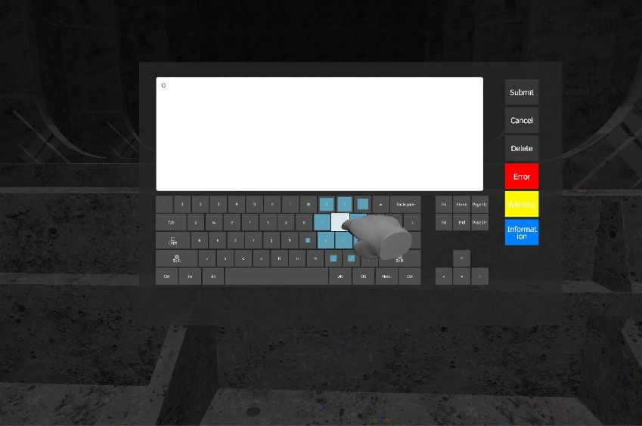
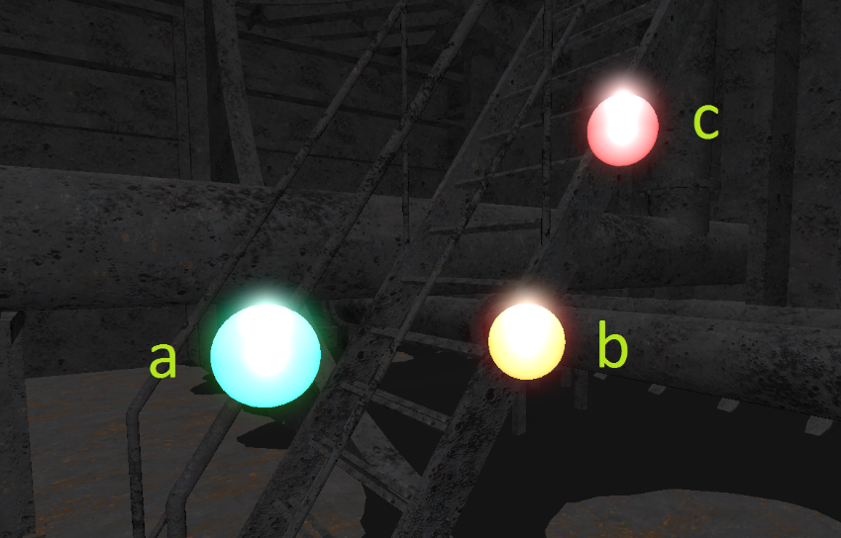
Editing annotations
Once the user interacts (i.e points or clicks) on an annotation the annotation form opens up.
The user can use gestures to input a short message and give the annotation a priority, and can then either submit the changes, cancel them or delete the annotation.
Priorities are colour coded: a) normal, b) important, c) very important.

Slide 12
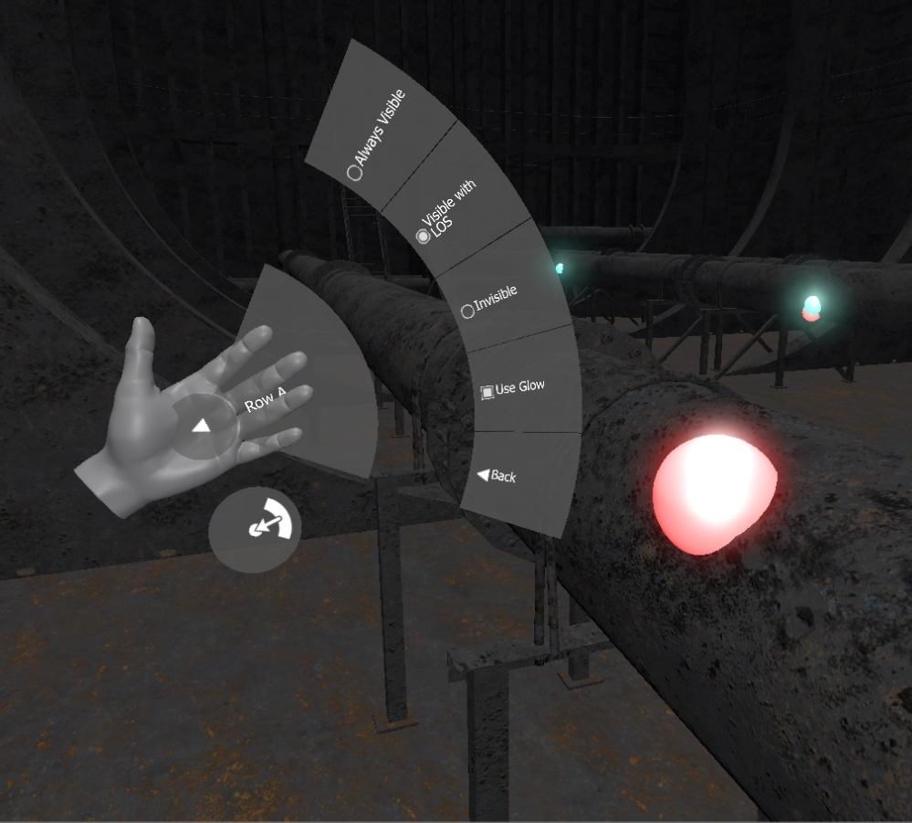
Using gesture for menu interactions
The menu enables the user to select between some limited options.
These include annotation visibility level, movement-gesture scheme and a couple of others.
Activates when the user turns a palm against the camera. Buttons are selected by the opposite hand’s index finger.

Slide 13
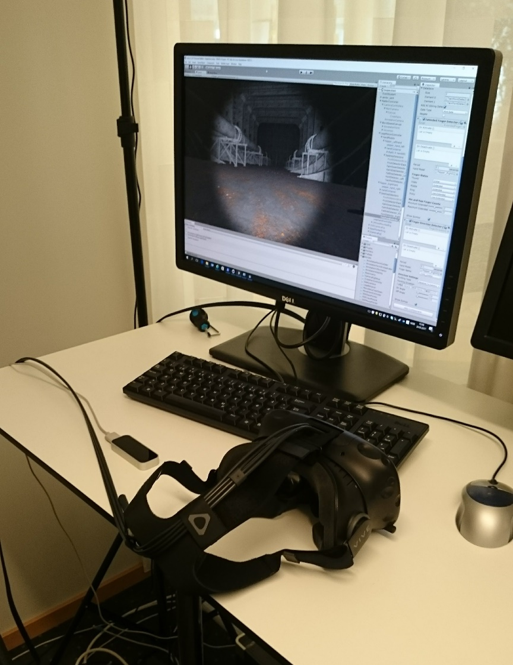
User evaluation
To evaluate the application, and various design hypothesis, the application was tested by three DNV-GL employees.
All unfamiliar with VR
All participants were given the same introduction, instructions and questions.
Some responses seem to be personal opinion and some seem unanimous.

Slide 14
Findings

Slide 15
Future work

